Slide 1

How does the Average Temperature affect the Beer Consumption throughout the year in São Paulo. Submission Date: 25 -11 - 2024
Group Name: A195 Name of Student Presenting:
Notes:
Welcome to our presentation. Today, we are excited to share the findings of our research conducted around a university area in São Paulo, which examines the impact of temperature on beer consumption among young adults aged 18-28. We hope this study will enlighten us on how climatic conditions influence consumption patterns.

Slide 2
Introduction
Background: Study conducted in a university area in São Paulo, analyzing the impact of temperature on beer consumption among young adults aged 18-28.
Purpose: To determine if temperature and beer consumption are correlated throughout the year in Sao Paulo.
Notes:
Our research was initiated to explore whether warmer temperatures correlate with increased beer consumption. Given the diverse climate of São Paulo, understanding these patterns can provide valuable insights for local businesses, especially those in the beverage industry

Slide 3
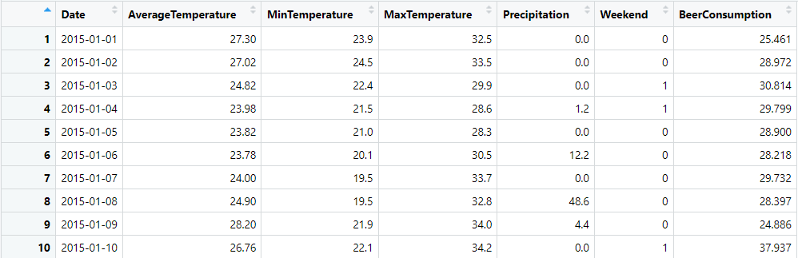
Dataset Overview
Dataset ID: DS106 - Beer Consumption – São Paulo
Observation Period: 365 days
No. of Rows and Columns: 365 and 7.
Variables:
Independent Variable: Average Temperature (Interval Data)
Dependent Variable: Beer Consumption (Interval Data)
Notes:
The dataset we used spans across 365 days and specifically records daily beer consumption and temperature variations. By analyzing this data, we aim to establish a relationship between the independent variable, average temperature, and the dependent variable, beer consumption in liters.

Slide 4
Research Question: How does the average temperature affect beer consumption in liters throughout the year in São Paulo?
Our Research Question is
Notes:
The core of our study centers around the question: "How does the average temperature affect beer consumption in liters throughout the year in São Paulo?" Addressing this question will help us understand potential market dynamics and consumer behavior.
You will get only one opportunity to present your Research Question ahead of the submission date. Have your questions ready, and be ready to take notes on feedback.

Slide 5
Null Hypothesis (H₀): There is no correlation between average temperature and beer consumption. Alternative Hypothesis (H₁): There is a correlation between average temperature and beer consumption.
Hypothesis
Notes:
Our investigation led us to propose two hypotheses. The Null Hypothesis suggests that there is no correlation between average temperature and beer consumption. Conversely, the Alternative Hypothesis posits a positive correlation, implying that higher temperatures might increase beer consumption.

Slide 6
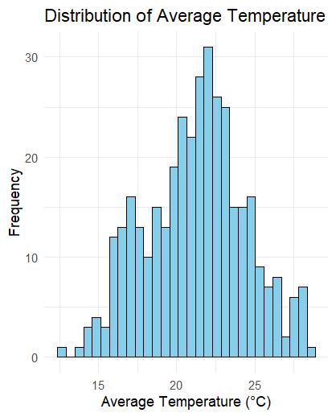
Histogram - Distribution of Average Temperature
The histogram shows a somewhat bimodal distribution, with peaks around 20°C and 25°C.
Notes:
This histogram illustrates the distribution of average temperatures over the year. The somewhat bimodal nature of this distribution points to significant variations in temperature, which could potentially affect consumption patterns.

Slide 7
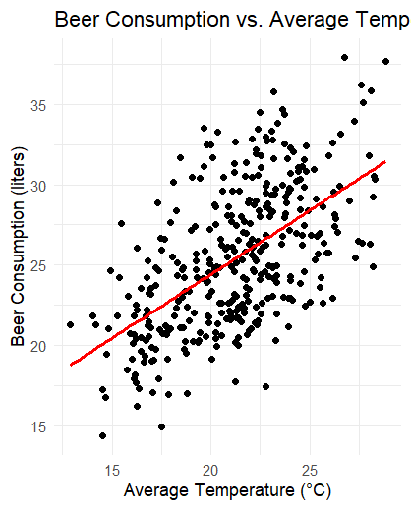
Scatter Plot - Beer Consumption vs. Average Temperature
The scatter plot with a regression line suggests a positive correlation between average temperature and beer consumption.
Notes:
Displayed here is a scatter plot that maps beer consumption against average temperature. The inclusion of a regression line indicates a positive trend, suggesting that as temperatures rise, beer consumption tends to increase as well.

Slide 8
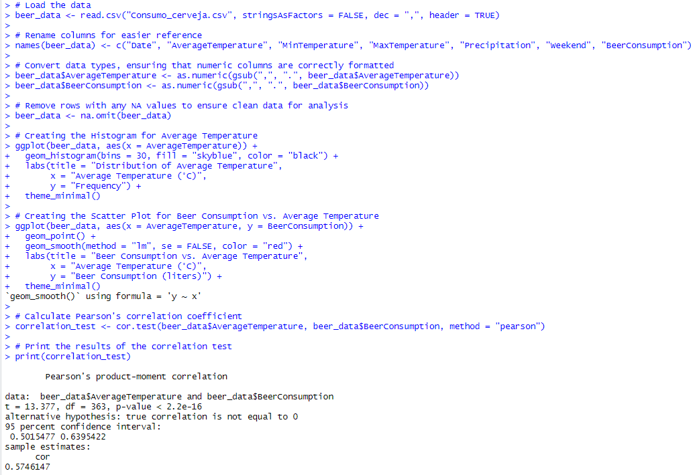
Statistical Analysis
Correlation Test Results:
Correlation Coefficient (r): 0.5746
P-value: < 2.2e-16
Interpretation: The results indicate a statistically significant positive correlation between average temperature and beer consumption.
Notes:
To quantify the relationship between temperature and beer consumption, we calculated Pearson’s correlation coefficient. The resulting value of 0.5746 and the extremely low p-value indicate a strong statistical significance, supporting the presence of a positive correlation.

Slide 9
Conclusion
Summary: The analysis confirms a significant positive correlation, supporting our alternative hypothesis.
Implications: This information could be useful for businesses and marketing strategies, particularly for beverage companies in São Paulo.
Notes:
To conclude, our analysis confirms a significant positive correlation between average temperature and beer consumption in São Paulo. This finding supports our Alternative Hypothesis and offers actionable insights for businesses in planning and optimizing their marketing strategies according to temperature trends.

